Slide 1



UC13 · ENTERPRISE DATA ENGINEERING
Enterprise Procurement Data Platform
Sprint 0 — Project Initiation & Architecture
5,000+
10
Agile Scrum
Domestic & international suppliers
Independent source systems
Sprint-based delivery model
ABC Global Manufacturing Ltd. · Sprint Presentation

Slide 2





Sprint 0: Purpose
PURPOSE
Establishing the business and technical foundation before development begins
Understand the procurement business ecosystem end to end
Identify stakeholders, data sources, and business problems
Define project scope, objectives, assumptions, and success criteria
Design the high-level solution architecture
Set up collaboration tooling and a structured delivery plan
Enterprise Procurement Data Platform · ABC Global Manufacturing Ltd.

Slide 3





Business Background
BACKGROUND
Why ABC Global needs a unified procurement platform
5,000+
10
1,000s
Domestic & international suppliers
Independent enterprise systems
Procurement transactions daily
Global sourcing
Raw materials, machinery, office supplies, and services procured from suppliers worldwide.
Disconnected systems
ERP, procurement, vendor, warehouse, inventory, finance, contract, and performance systems all operate independently.
Enterprise Procurement Data Platform · ABC Global Manufacturing Ltd.

Slide 4

Business Problem
PROBLEM
The compounding cost of disconnected systems
Independent systems
Fragmented data
Quality issues
Limited visibility
Delayed decisions
Supplier records are duplicated or inconsistent across systems
Purchase requests, orders, receipts, invoices, and payments are hard to connect
Supplier performance and contract compliance are difficult to monitor
Inventory replenishment and procurement cost control are less effective
Enterprise Procurement Data Platform · ABC Global Manufacturing Ltd.

Slide 5




Project Objective
OBJECTIVE
What the platform must achieve
Collect procurement data from heterogeneous enterprise sources
Clean, validate, and standardize procurement and supplier records
Store curated data in an enterprise PostgreSQL data warehouse
Maintain metadata, audit logs, and end-to-end data lineage
Enable procurement, supplier, inventory, and executive analytics
Collaborate using Git and GitHub with enterprise-standard documentation
Enterprise Procurement Data Platform · ABC Global Manufacturing Ltd.

Slide 6
Stakeholders
STAKEHOLDERS
Who uses or depends on the platform
Stakeholder | Main need
Procurement team | Spend, purchase orders, cycle time, supplier analysis
Supplier management | Ratings, delivery reliability, quality, compliance
Warehouse / inventory | Stock levels, replenishment, warehouse visibility
Accounts Payable / Finance | Invoices, payments, outstanding and overdue amounts
Executives | Trusted KPIs and consolidated reporting
Data / IT team | Reliable pipelines, governance, lineage, and support
Enterprise Procurement Data Platform · ABC Global Manufacturing Ltd.

Slide 7
Procurement Business Lifecycle
LIFECYCLE
The business process represented by the data
Requirement
Requisition
Approval
Supplier / Contract
Purchase Order
Delivery / Receipt
Invoice / Payment
The platform connects these events so a single procurement transaction can be traced end to end, from initial request through final payment.
Enterprise Procurement Data Platform · ABC Global Manufacturing Ltd.

Slide 8

Scope and Boundaries
SCOPE
What is included in the project
In scope
Out of scope (prototype)
Procurement, suppliers, products, contracts, requisitions, purchase orders, inventory, warehouses, invoices, and supplier performance
Direct integration with real production systems and live enterprise transactions
Ingestion, staging, profiling, quality checks, warehouse modeling, lineage, metadata, dashboards, testing, and documentation
The prototype uses representative datasets to demonstrate an enterprise-scale design
Enterprise Procurement Data Platform · ABC Global Manufacturing Ltd.

Slide 9
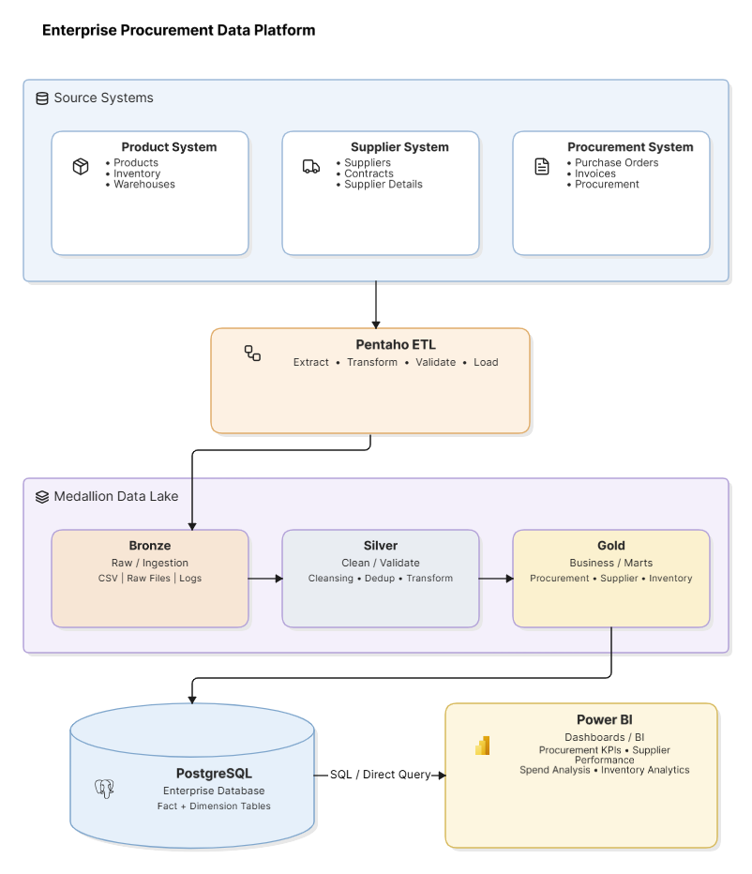
Proposed Solution Architecture
ARCHITECTURE
Enterprise Procurement Data Platform · ABC Global Manufacturing Ltd.

Slide 10


Architecture Layers
LAYERS
Why the platform is separated into trust tiers
Bronze
Silver
Gold
Preserve source data as received
Clean, standardize, and validate
Serve business analytics
Raw files and staging tables, kept unmodified for traceability and reprocessing.
Conformed supplier, procurement, inventory, and invoice records.
Fact tables, dimension tables, data marts, and KPI-ready data.
Enterprise Procurement Data Platform · ABC Global Manufacturing Ltd.

Slide 11

Technology Stack
TECH STACK
Tools selected for the solution
Area | Technology | Role
ETL | Pentaho Data Integration (Spoon) | Extract, transform, validate, and load
Database | PostgreSQL | Staging, warehouse, marts, logs, and metadata
Programming | Python / Pandas | Profiling, cleansing, and analysis
Reporting | Power BI | Dashboards and executive reporting
Version control | Git / GitHub | Collaboration, history, and releases
Methodology | Agile Scrum | Sprint planning and incremental delivery
Enterprise Procurement Data Platform · ABC Global Manufacturing Ltd.

Slide 12


Project Repository Structure
REPOSITORY
How project artifacts will be organized
docs/
datasets/
BRD, architecture, data dictionary, reports, presentations
Representative source data organized by business domain
pentaho/
python/
ETL transformations and orchestration jobs
Profiling, cleansing, and analysis scripts
sql/
metadata/ & lineage/
Database, staging, warehouse, and analytics scripts
Governance artifacts and source-to-target mapping
dashboards/
tests/
Power BI output and screenshots
ETL, database, and data-quality validation evidence
Enterprise Procurement Data Platform · ABC Global Manufacturing Ltd.

Slide 13

Sprint 0 Deliverables
DELIVERABLES
Evidence that the project is ready to begin development
Business Requirement Document (BRD)
Solution architecture diagram and architecture document
GitHub repository with enterprise folder structure
Product backlog and sprint backlog
Project charter — scope, stakeholders, assumptions, risks, success criteria
All five deliverables complete — ready to begin Sprint 1 source discovery and ingestion.
Enterprise Procurement Data Platform · ABC Global Manufacturing Ltd.

Slide 14

SPRINT 0 · CONCLUSION
The project direction is now established
We understand the business problem and its impact on procurement operations
We know which systems and datasets are relevant to the platform
We have defined the target architecture and technology stack
We have planned the repository structure and delivery process
Sprint 1 begins with source discovery and raw-data ingestion into PostgreSQL staging tables.
Enterprise Procurement Data Platform · ABC Global Manufacturing Ltd.

